Slide 1
Topic 9: Monopoly

Slide 2
Monopoly
While a competitive firm is a price taker, a monopoly firm is a price maker.
A firm is considered a monopoly if . . .
it is the sole seller of its product.
its product does not have close substitutes.
The fundamental cause of monopoly is barriers to entry.

Slide 3
WHY MONOPOLIES ARISE
Barriers to entry have three sources:
Ownership of a key resource.
The government gives a single firm the exclusive right to produce some good.
Costs of production make a single producer more efficient than a large number of producers.

Slide 4
Monopoly of Resources: Although exclusive ownership of a key resource can be a source of monopoly, in practice monopolies rarely arise for this reason.
Monopolies: Governments may restrict entry by giving a single firm the exclusive right to sell a particular good in certain markets. Patent and copyright laws are two important examples of how government creates a monopoly.
Natural Monopolies: when a single firm can supply a good or service to an entire market at a lower cost than could two or more firms. It arises when there are economies of scale over the relevant range of output.

Slide 5
Economies of Scale as a Cause of Monopoly
Cost
Average
total
cost
0
Quantity of Output

Slide 6
Monopoly versus Perfect Competition
Monopoly
Is the sole producer
Faces a downward-sloping demand curve
Is a price maker
Reduces price to increase sales
Competitive Firm
Is one of many producers
Faces a horizontal demand curve
Is a price taker
Sells as much or as little at same price

Slide 7
Demand Curves for Competitive and Monopoly Firms
(a) A Competitive Firm’s
(b) A Monopolist’s
Demand Curve
Price
Demand Curve
Price
’
’
Demand
Demand
0
0
Quantity of Output
Quantity of Output
Since a monopoly is the sole producer in its market, it faces the market demand curve.

Slide 8
A Monopoly’s Revenue
Total Revenue
P × Q = TR
Average Revenue
TR/Q = AR = P
Marginal Revenue
∆TR/∆ Q = MR

Slide 9
A Monopoly’s Total, Average, and Marginal Revenue

Slide 10
A Monopoly’s Revenue
A Monopoly’s Marginal Revenue
A monopolist’s marginal revenue is always less than the price of its good.
The demand curve is downward sloping.
When a monopoly drops the price to sell one more unit, the revenue received from previously sold units also decreases.

Slide 11
A Monopoly’s Revenue
A Monopoly’s Marginal Revenue
When a monopoly increases the amount it sells, it has two effects on total revenue (P × Q).
The output effect—more output is sold, so Q is higher.
The price effect—price falls, so P is lower.

Slide 12
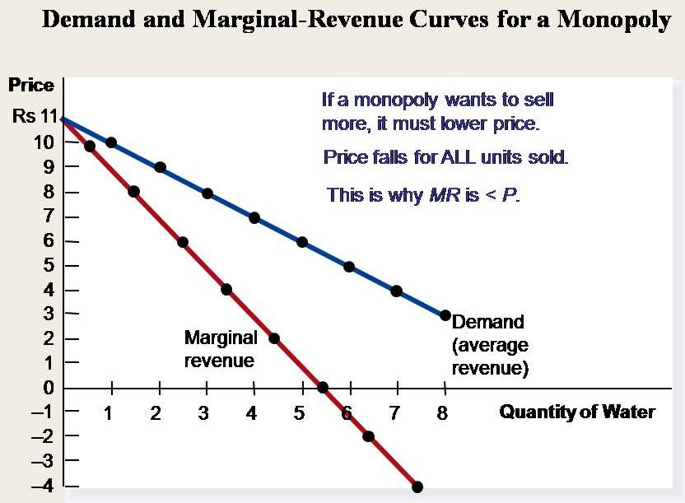

Slide 13
Profit Maximization
A monopoly maximizes profit by producing the quantity at which marginal revenue equals marginal cost.
It then uses the demand curve to find the price that will induce consumers to buy that quantity.

Slide 14
Figure 4 Profit Maximization for a Monopoly
Costs and
Revenue
2. . . . and then the demand
1. The intersection of the
curve shows the price
marginal-revenue curve
consistent with this quantity.
and the marginal-cost
curve determines the
B
profit-maximizing
Monopoly
quantity . . .
price
Average total cost
A
Marginal
Demand
cost
Marginal revenue
0
Q
Q_{MAX}
Q
Quantity

Slide 15
Profit Maximization
Comparing Monopoly and Competition
For a competitive firm, price equals marginal cost.
P = MR = MC
For a monopoly firm, price exceeds marginal cost.
P > MR = MC
Remember, all profit-maximizing firms set MR = MC.

Slide 16
A Monopoly’s Profit
Profit equals total revenue minus total costs.
Profit = TR – TC
Profit = (TR/Q – TC/Q) × Q
Profit = (P – ATC) × Q

Slide 17
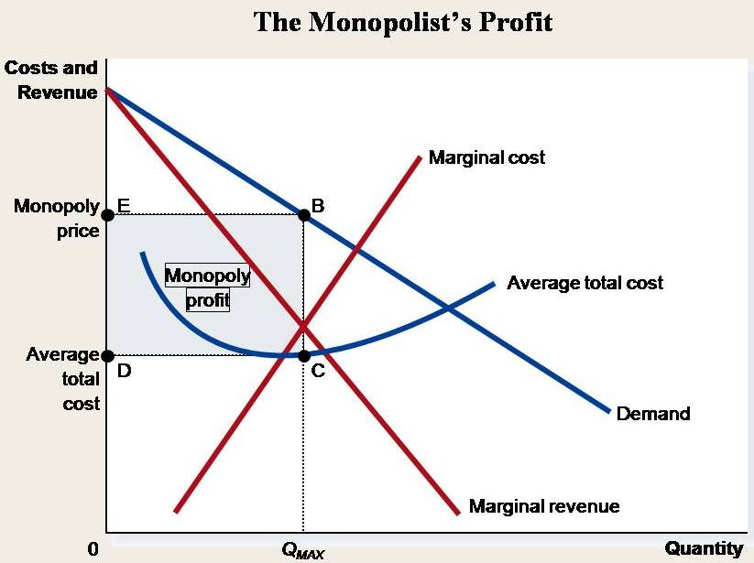

Slide 18
A Monopolist’s Profit
The monopolist will receive economic profits as long as price is greater than average total cost.

Slide 19
THE WELFARE COST OF MONOPOLY
In contrast to a competitive firm, the monopoly charges a price above the marginal cost.
From the standpoint of consumers, this high price makes monopoly undesirable.
However, from the standpoint of the owners of the firm, the high price makes monopoly very desirable.

Slide 20
PUBLIC POLICY TOWARD MONOPOLIES
Government responds to the problem of monopoly in one of four ways.
Making monopolized industries more competitive.
Regulating the behavior of monopolies.
Turning some private monopolies into public enterprises.
Doing nothing at all.

Slide 21
PRICE DISCRIMINATION
Price discrimination is the business practice of selling the same good at different prices to different customers, even though the costs for producing for the two customers are the same.
Monopolists can raise their profits by charging different prices to different buyers based on their willingness to pay.
Perfect Price Discrimination
Perfect price discrimination refers to the situation when the monopolist knows exactly the willingness to pay of each customer and can charge each customer a different price.

